Slide 1
BLIS - User Training
2016

Slide 2


Hello!
I am Amit Dugar
Deforay Technologies, India
Email : amit@deforay.com
Skype : amitdgr

Slide 3
C4G BLIS
Basic Laboratory Information System

Slide 4
C4G Basic Laboratory Information System (BLIS) is an open-source system to track patient specimens and laboratory results.

Slide 5
CHALLENGES FACED BY LABS
Non-Standardized Logbooks
Sample Labeling and Workflow Management
Data Storage, Retrieval and Analysis

Slide 6
WHY BLIS ?
Targeted to Technicians, Clinicians, Hospital Directors
Automation of Lab Processes (Patient, Specimen, Test Registration, Test Result Recording, Verification, Generating Patient Reports, Daily Logs, Test Counts, Doctor Statistics etc.)
Flexible and Configurable
Customizable Reports

Slide 7
FEATURES
One-time entry of each unique patient
Standardization of data collected (allowable entries for specimen type, test type, patient data, reagents are set at MOH level and then entered consistently throughout a country)
Customization to a country’s needs
Ability to track lab supplies such as test kits, reagents
Ability to run reports as specified by a country
Automatic alerting of data values that may be out of range(reference ranges and panic values are set at the regional or national level)
Daily logs to be reviewed for data verification
Simple data backup

Slide 8
BENEFITS
Reduced burden for technicians, as results are available soon after testing
Improved consistency of data entry
Ability to view patient history and track samples
Ability to aggregate data and analyze data patterns and trends at a regional or national level
Printed patient records in place of handwritten records
Printed daily logs that make the reports look like the paper forms used in the laboratory

Slide 9
BENEFITS OF FREE AND OPEN SOURCE
No licensing costs
Source Code is available for anyone to go through
Application can be extended to add features and functionality depending on any specific country requirements
Complete control over the system

Slide 10
Let’s Get Started
A quick run to see how BLIS looks and feels

Slide 11
Setup Instructions
Downloads are available at the C4G BLIS Website (http://blis.cc.gatech.edu/download.php)
At the time of this training the latest stand-alone version is version 3.0
SETTING UP STAND-ALONE VERSION (v3.0)
Download the latest Stand-alone Version
Unzip the downloaded file and move the folder to a convenient place
Click on BLIS.exe to run the software
Wait for C4G BLIS to startup, then login in as admin.
Set up the Lab Configurations as per requirement and create Technicians
UPDATING BLIS (from v3.0 to v3.1)
Download and Extract the update file.
Open the folder called "Update3.1" and copy all the files inside and replace them to your C4G BLIS folder.
Run update_C4GBLIS_v3-1.bat to start the update process.
Wait for C4G BLIS to startup, then login in as admin and complete the update process by clicking on the 'Complete update' link displayed on the home screen
Login using the credentials cameroon_dir/dir123 (as country director), testlab1_admin/admin123 (as admin) or testlab1_tech1, testlab1_tech2/tech123 (as lab technician)

Slide 12
RUNNING ON A LAN
BLIS can be run on a LAN with the help of the BlisSetup.html file that gets created when starting up BLIS
Copy this file and run it from any computer on the network

Slide 13
EXERCISE
Let us now set-up BLIS

Slide 14
BLIS ROLES
DIRECTOR
Country Director : National Level Access
Create Labs
Create Lab Managers
Set up Test Catalog
LAB ADMIN
Lab Admin : Lab Level Access
Lab Configuration
Manage Test Catalog for that particular Lab
Reports
Backup
TECHNICIAN
Technician : Lab Level Access
Patient Registration
Specimen, Test Results, Reports
Inventory
Backup

Slide 15
DIRECTOR

Slide 16
LAB SETUP - STEP 1
Download & Run BLIS
Login as Country Director
Create/Configure Lab
Setup Test Catalog
Create Lab Admin

Slide 17
LAB SETUP - Step 2
Download & Run BLIS
Login as Country Director
Create/Configure Lab
Setup Test Catalog
Create Lab Admin

Slide 18
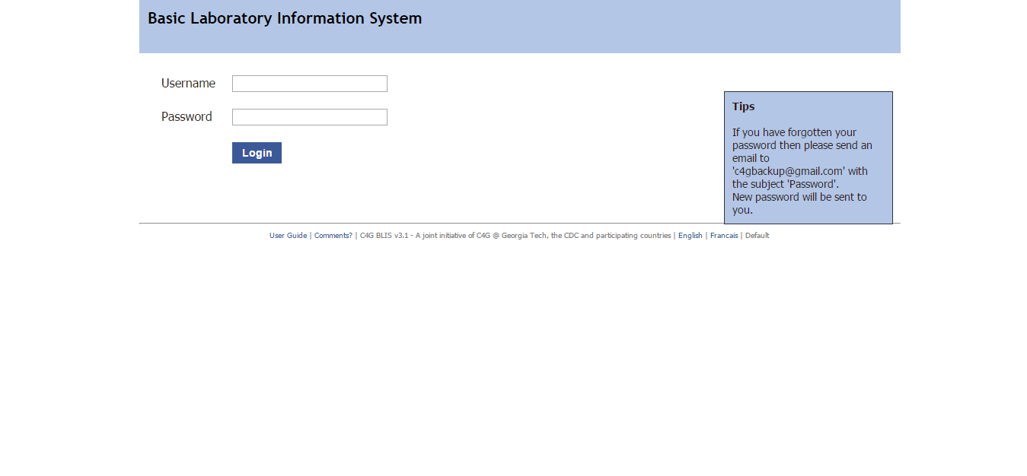
cameroon_dir/dir123 (as director)

Slide 19
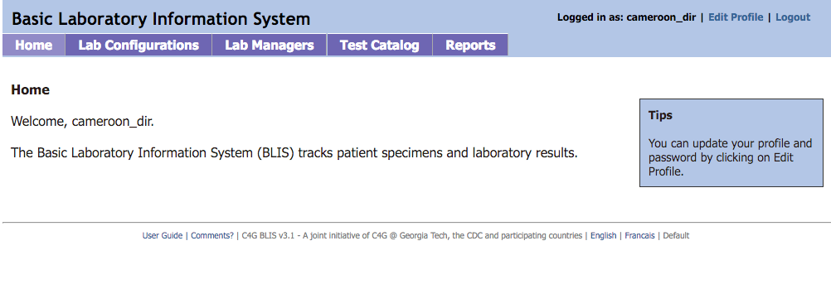
DIRECTOR HOME PAGE

Slide 20
LAB SETUP - STEP 3
Download & Run BLIS
Login as Country Director
Create/Configure Lab
Setup Test Catalog
Create Lab Admin

Slide 21
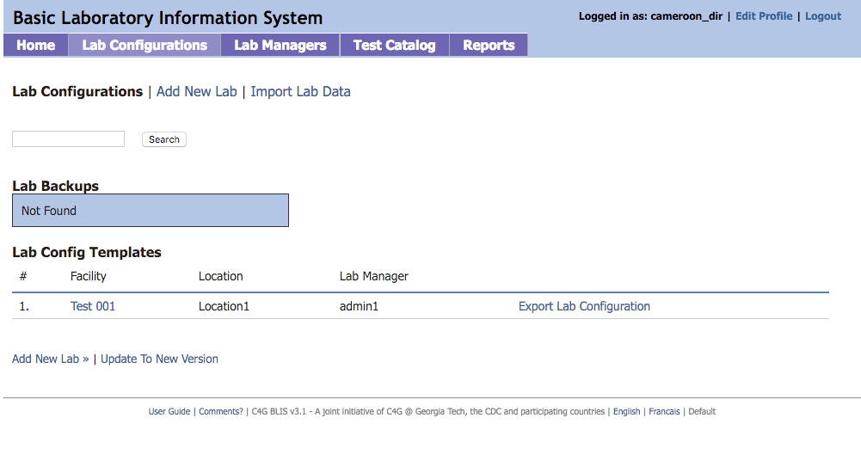
LAB CONFIGURATIONS

Slide 22
LAB SETUP - STEP 4
Download & Run BLIS
Login as Country Director
Create/Configure Lab
Setup Test Catalog
Create Lab Admin

Slide 23
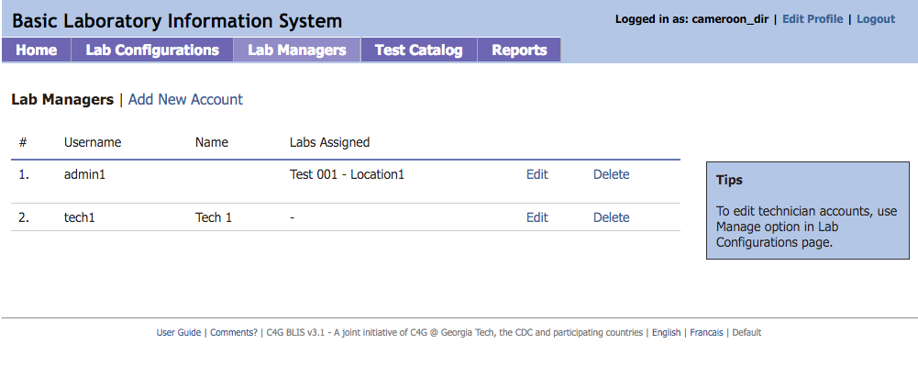
LAB MANAGERS

Slide 24
LAB SETUP - STEP 5
Download & Run BLIS
Login as Country Director
Create/Configure Lab
Setup Test Catalog
Create Lab Admin

Slide 25
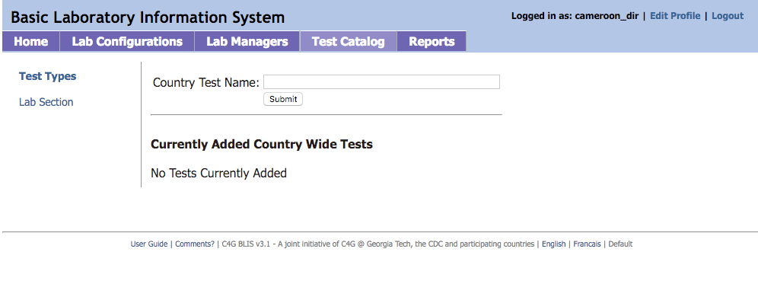
TEST CATALOG

Slide 26
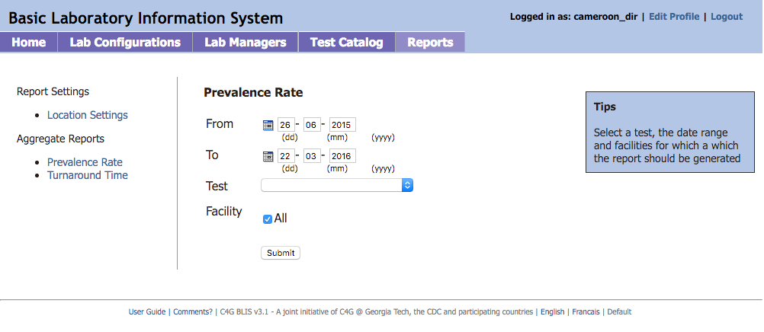
REPORTS

Slide 27
SIMPLE EXERCISE
Let us now create a lab and configure it according to our needs

Slide 28
ADMINISTRATOR

Slide 29
testlab1_admin/admin123 (as admin) or
testlab1_tech1, testlab1_tech2/tech123 (as lab technician)

Slide 30
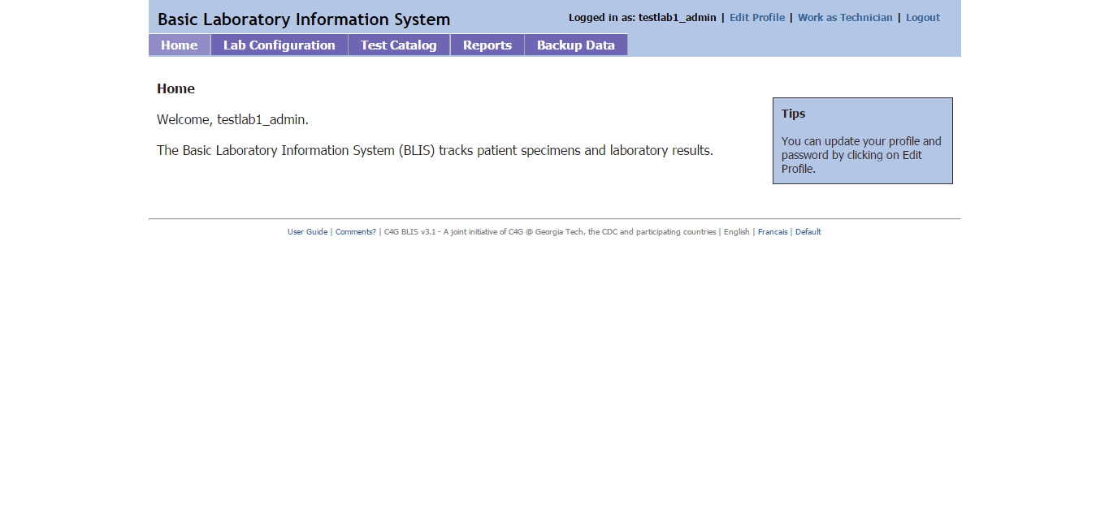
To switch to technician view, click the Work as Technician link at the top right of the page. To go back to the manager view, click the Work as Manager link that will be in the same place on the screen.

Slide 31
LAB CONFIGURATION
The lab configuration section allows you to change how reports are generated, what patient data is collected, as well as various other settings.
These settings are usually set by the director at the country level, and can be imported/exported through the same page the settings are decided.

Slide 32
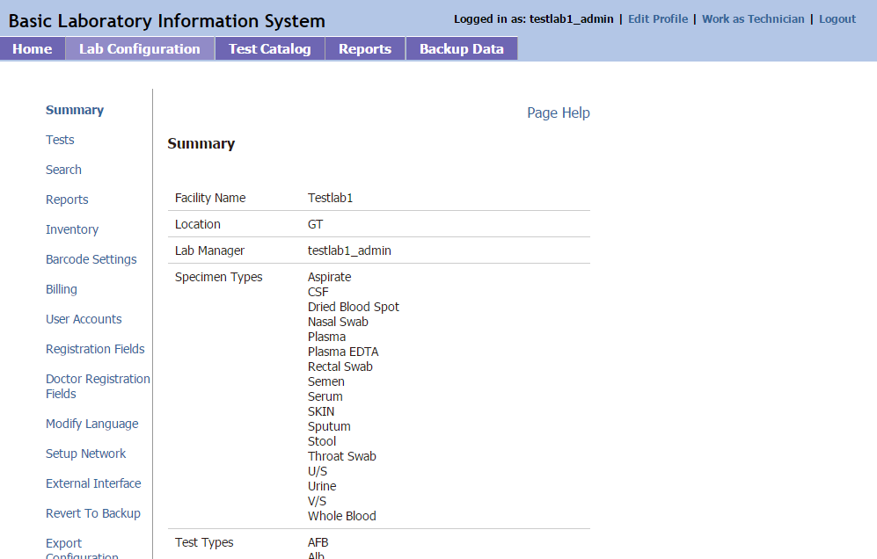
LAB CONFIGURATION
Let us explore the various options under the Lab Configuration page

Slide 33
SIMPLE EXERCISE
Let us now configure our Standard Lab Settings.

Slide 34
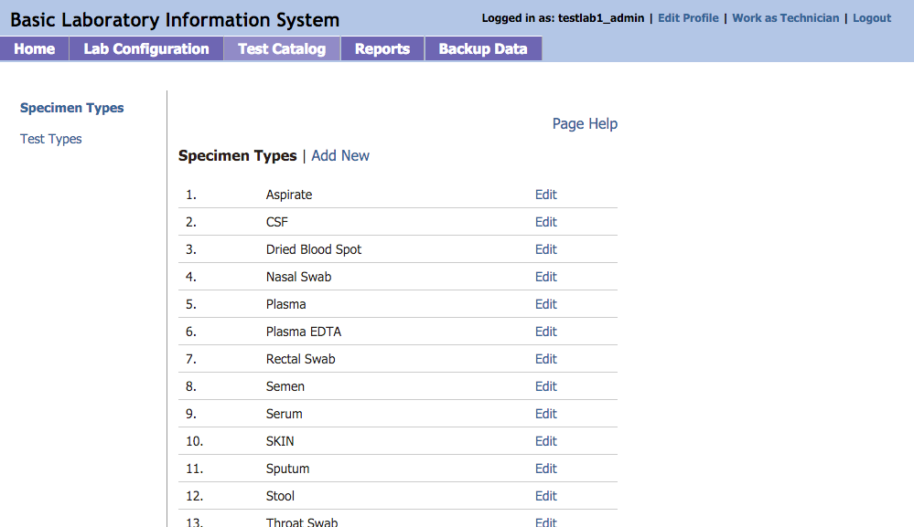
TEST CATALOG

Slide 35
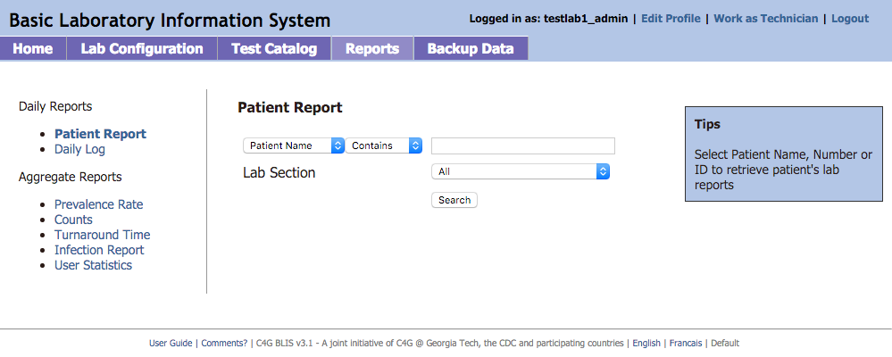
REPORTS CONFIG

Slide 36
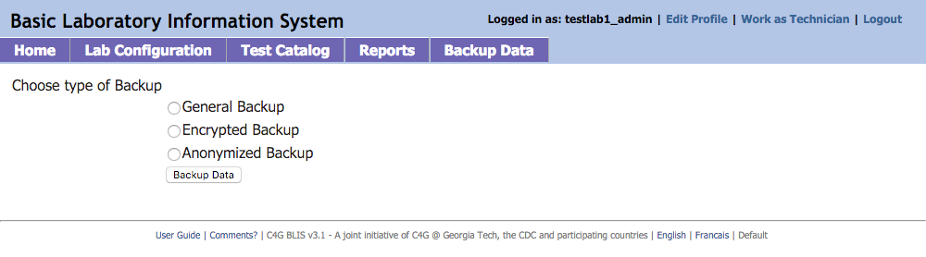
BACKUPS

Slide 37
TECHNICIAN

Slide 38
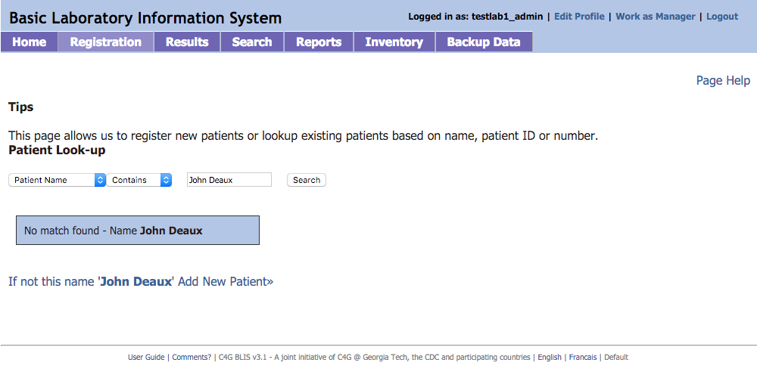
PATIENT SEARCH/REGISTRATION

Slide 39
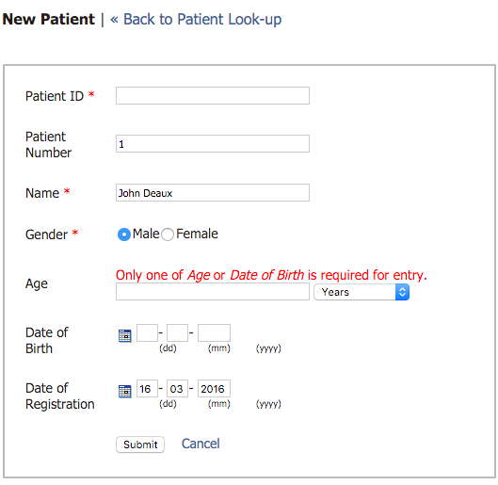
ADD PATIENT

Slide 40
EXERCISE
LET US ADD A NEW PATIENT NOW

Slide 41
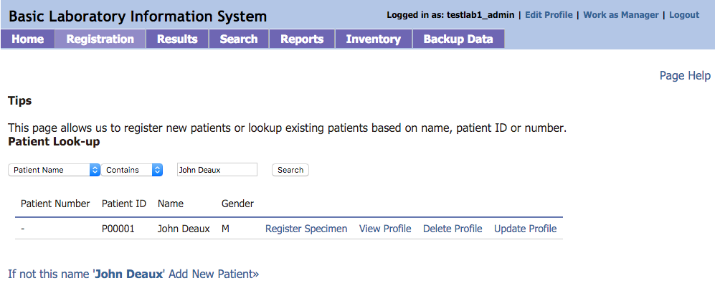
SEARCH PATIENT

Slide 42
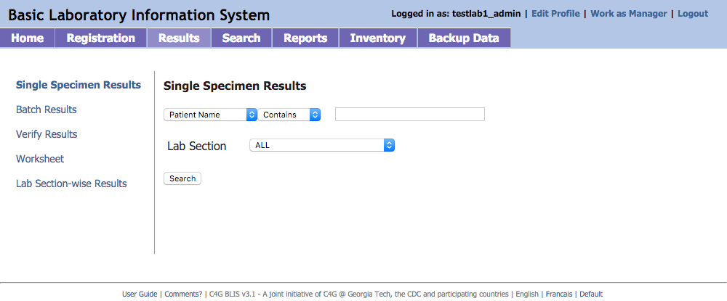
RESULTS

Slide 43
WALKTHROUGH & EXERCISE
1) Add Specimen and Test Results (Single and Batch)
2) Verify Test Results
3) Worksheets
4) Lab Section-wise Results

Slide 44
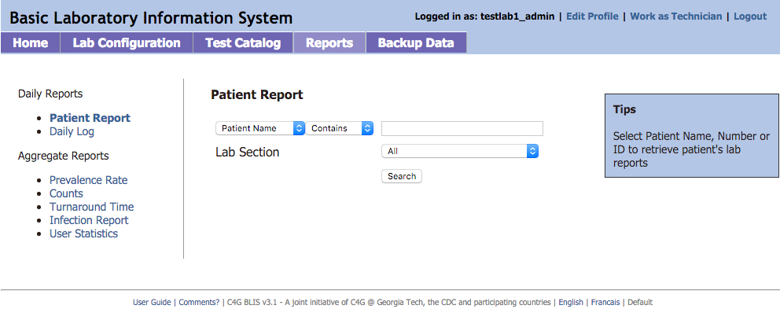
REPORTS

Slide 45
EXERCISE
Try out different Daily and Aggregate Reports

Slide 46
Thanks!
Any questions?
You can reach me at:
Email : amit@deforay.com
Skype : amitdgr

